Slide 1
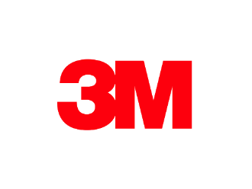


Impact of High Efficiency Filters on Energy Consumption – A Comprehensive Experimental Study
Seminar 50 (Intermediate)
John Zhangª, Abby Lemonª, Doug Huntleyª,
Stuart K. Morgan^{b}, David A. Alfano^{b}, Winfield S. Morter^{b}, Brian R. Butler^{b}
a: Construction and Home Improvement Markets Division, 3M Company, St. Paul, MN, USA
b:The Helix Innovation Center, Emerson Electric Company, Dayton, OH, USA
Presentation in ASHRAE Conference
June 29, 2020

Slide 2
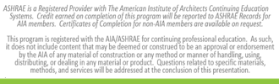
Learning Objectives
Understand the relationship between filter efficiency and system energy efficiency for residential forced air systems.
Learn how current methods remove/clean air contaminants using various filters in residences and residential-like systems.
Provide information how various particulate and/or gaseous filters are used in residential and office buildings and how they impact on human health.
Learn how to monitor and track IAQP goals for single-family residences and/or office buildings.

Slide 3
Outline
Background
System description
Filter description
Test method
Test results
Summary/Conclusions

Slide 4
Background
Indoor pollutants such as smoke, molds and pet dander, as well as gaseous and vapor pollutants, have significant negative impact on public health.
High efficiency filters are used more and more extensively in residential HVAC.
Lot of modeling work on energy impact of HE filters.
Limited experimental work with many compounding factors.
Key question: does high efficiency filter consume more energy than low efficiency FG filter?

Slide 5
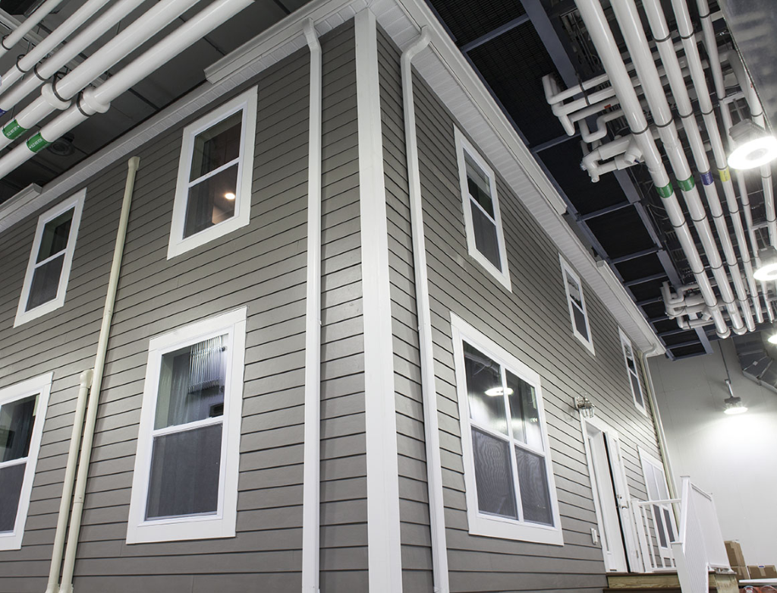
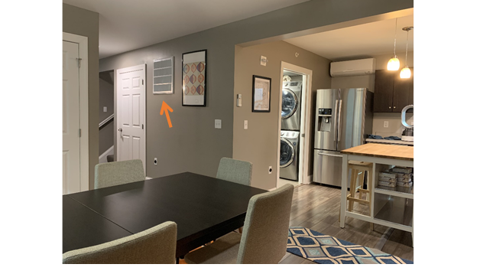
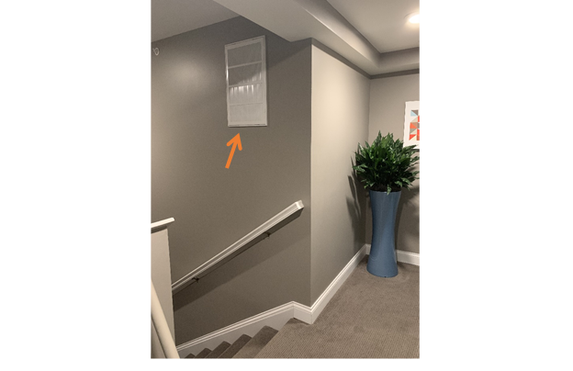
System Description
Test Hom in Environmental Chamber
Fully furnished and fully operational 2000 square foot, two story residential home in an environmentally controlled chamber.
Central forced-air heat pump system: condensing unit, electric heat furnace

Slide 6
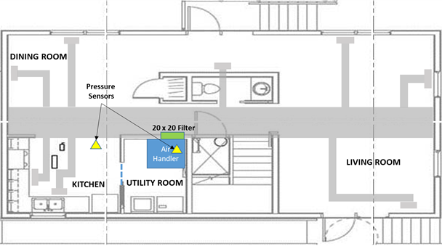
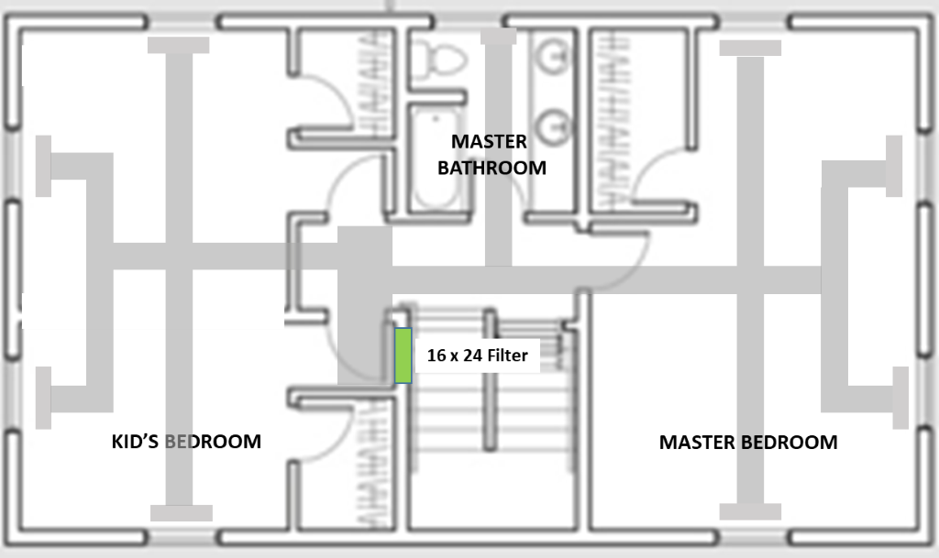
Collective Pressure Drop
Positioning of the differential pressure sensor
Layout of the ductwork in the home
Differential pressure is referenced as the collective filter pressure drop.

Slide 7
Filtration Properties of Test Filters
Filter⁽²⁾ | Filter Media | Electrostatic Charge | Average Pressure Drop @ 295FPM | MERV⁽¹⁾ Rating
Fiberglass, 20 x 20 | Fiberglass | No | 0.06 "H2O | NA
Fiberglass, 14 x 25 | Fiberglass | No | 0.09 "H2O | NA
MERV8 Electrostatic Filter-clean, 20 x 20 | Polypropylene | Yes | 0.23 "H2O | MERV 8
MERV8 Electrostatic Filter-dirty, 20 x 20 | Polypropylene | Yes | 0.34 "H2O | MERV 8
MERV8 Electrostatic Filter-clean, 14 x 25 | Polypropylene | Yes | 0.26 "H2O | MERV 8
MERV8 Electrostatic Filter-dirty, 14 x 25 | Polypropylene | Yes | 0.39 "H2O | MERV 8
MERV13 Electrostatic Filter-clean, 20 x 20 | Polypropylene | Yes | 0.18 "H2O | MERV 13
MERV13 Electrostatic Filter-dirty, 20 x 20 | Polypropylene | Yes | 0.28 "H2O | MERV 13
MERV13 Electrostatic Filter-clean, 14 x 25 | Polypropylene | Yes | 0.22 "H2O | MERV 13
MERV13 Electrostatic Filter-dirty, 14 x 25 | Polypropylene | Yes | 0.32 "H2O | MERV 13
* Dirty FG filters were dropped due to concerns of particle shedding and contamination.

Slide 8
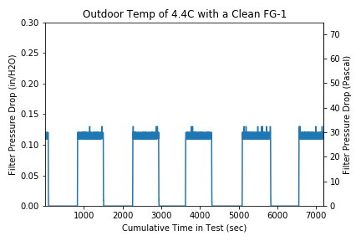
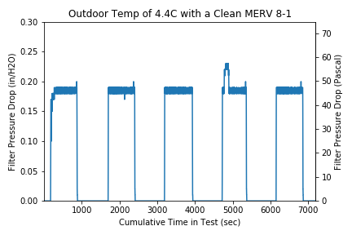
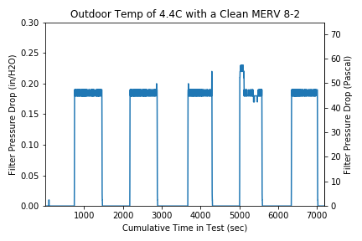
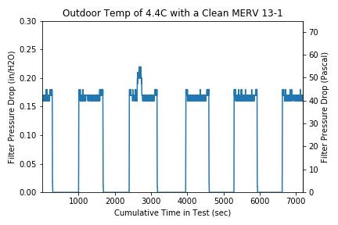
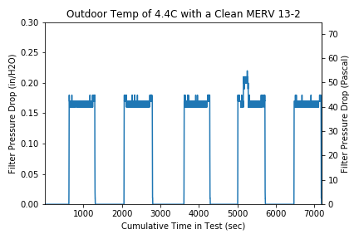
Pressure Drop vs Time Relationships

Slide 9
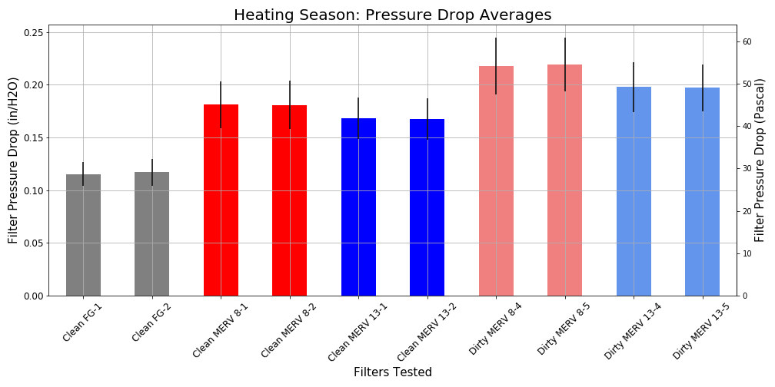
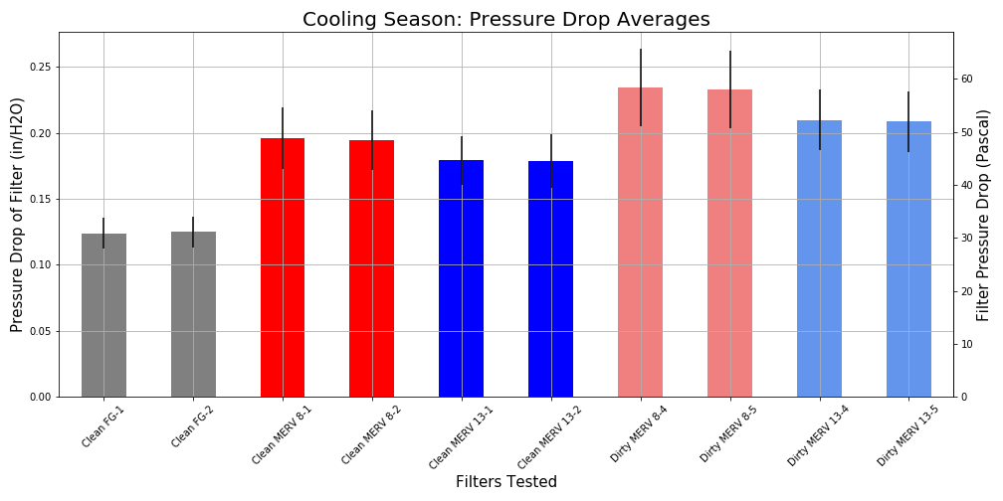
Heating Season Pressure Drop
Cooling Season Pressure Drop

Slide 10
Energy Results

Slide 11
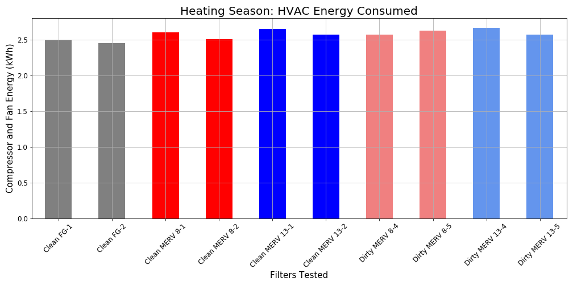
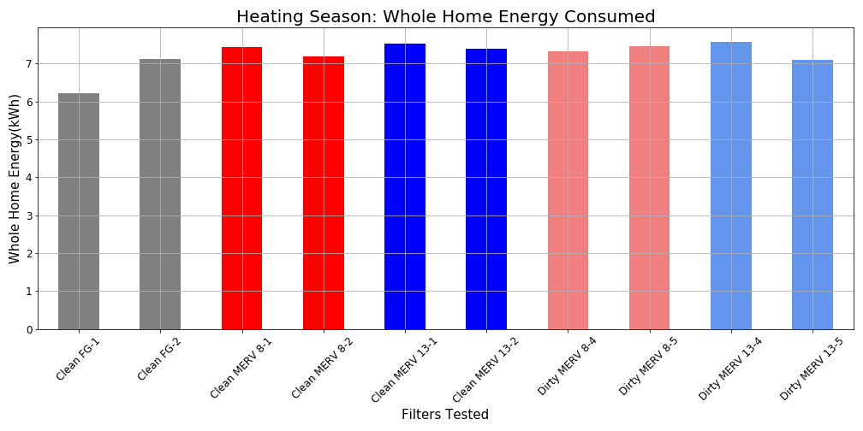
Heating Season Energy Consumption
HVAC System Energy Consumption
Whole House Energy Consumption
This discrepancy can be attributed to the lack of a heat pump defrost cycle in clean fiberglass filter 1 test.

Slide 12
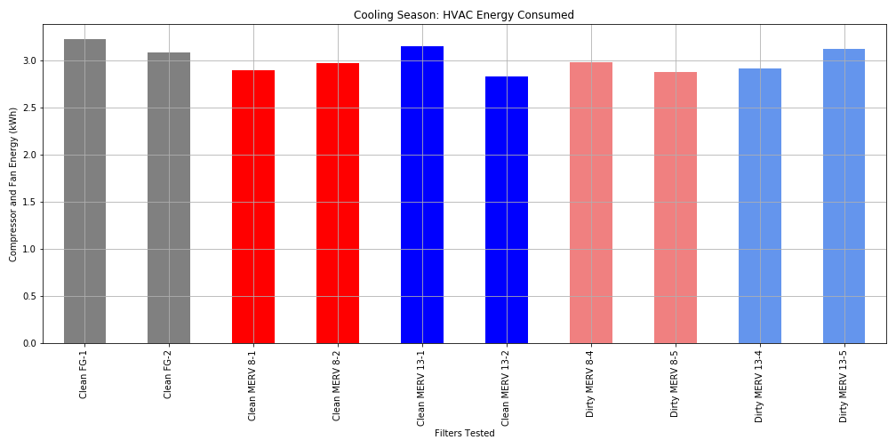
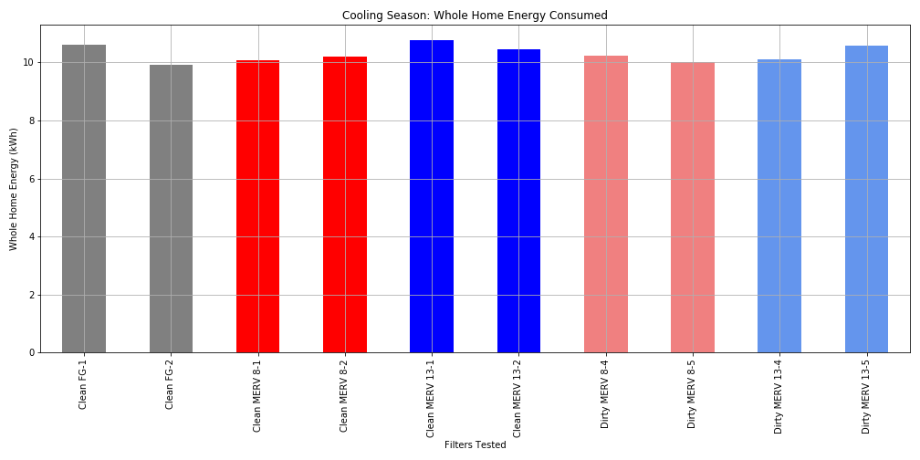
Cooling Season HVAC Energy Consumption
HVAC System Energy Consumption
Whole House Energy Consumption

Slide 13
Conclusions
High efficiency electrostatic filters do not necessarily consume more energy than low efficiency fiberglass filters.
High efficiency electrostatic filters can maintain the similar level of energy consumption throughout the designed service life of the filter.
Higher efficiency electrostatic filters do not necessarily have higher pressure drop than lower efficiency filters, because the filter pressure drop depends mostly on the filter media and filter design.

Slide 14
Presenter Biography
Dr. John Zhang has over 30 years of experience in air filtration and particle technologies. He has conducted extensive research in aerosol science, filtration media, filtration systems, instrumentation for filter testing and particle measurement.
Currently he is a Sr. Specialist in 3M Company. At this position he is responsible for developing innovative filtration technologies for residential air filtration. Prior to joining 3M in 1992, he served as a research scientist for Thermal System Inc., where he was involved in developing filter testing equipment and aerosol measurement instrumentation.
Dr. Zhang has published more than 40 technical papers related to the particle technology and filtration field, chaired sessions for AFS. He actively participates in technical societies and standard committees.

Slide 15
Questions?
John Zhang*, Abby Lemonª, Doug Huntleyª,
Stuart K. Morgan^{b}, David A. Alfano^{b}, Winfield S. Morter^{b}, Brian R. Butler^{b}
zzhang2@mmm.com
Data analysis on GitHub:
https://github.com/abbylemon/HighEfficientFilterEnergyTest

